Slide 1
Network analysis

Slide 2
Datasets and tools
Data: mrredges-no-tweet-no-retweet-poi-counted
Tools: Python, Networkx, Matplotlib
Graph | Nodes | Edges | Self-loop | Density | Is_connected
DiGraph of Reply | 4038 | 28992 | 0 | 0.00177849689775 | NA
DiGraph of Mention | 3513 | 17227 | 0 | 0.00139629440146 | NA
UnDiGraph of Reply | 4038 | 22062 | 0 | 0.00270676038619 | False
UnDiGraph of Mention | 3513 | 15429 | 0 | 0.00250112339005 | False

Slide 3
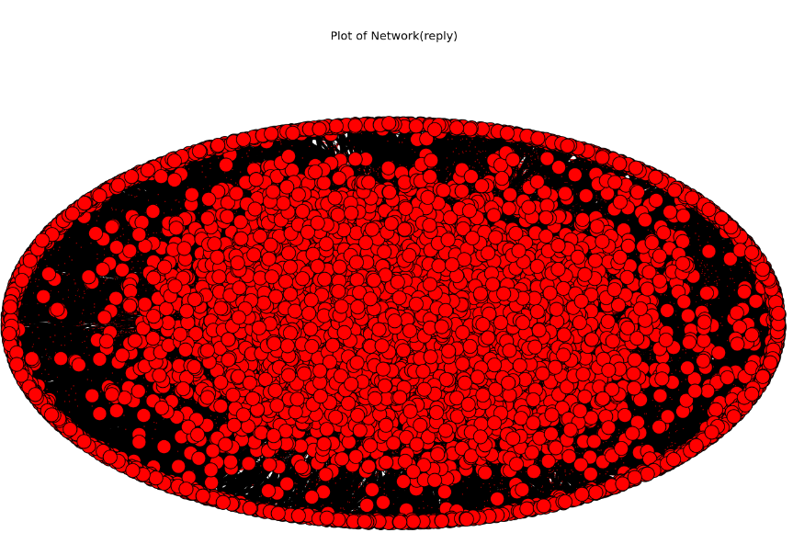
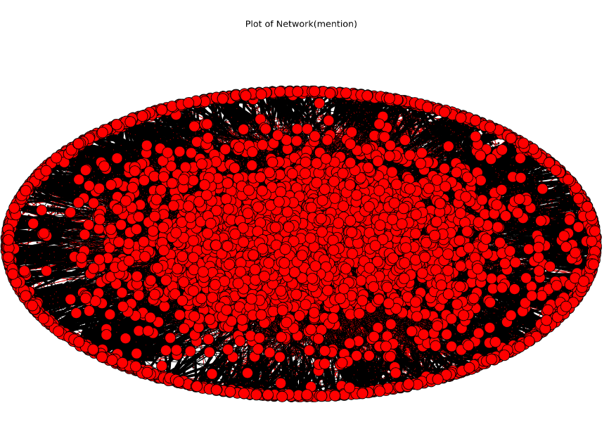
digraph Topology of network
The nodes in mention network seems more partitionable than those in reply network.

Slide 4
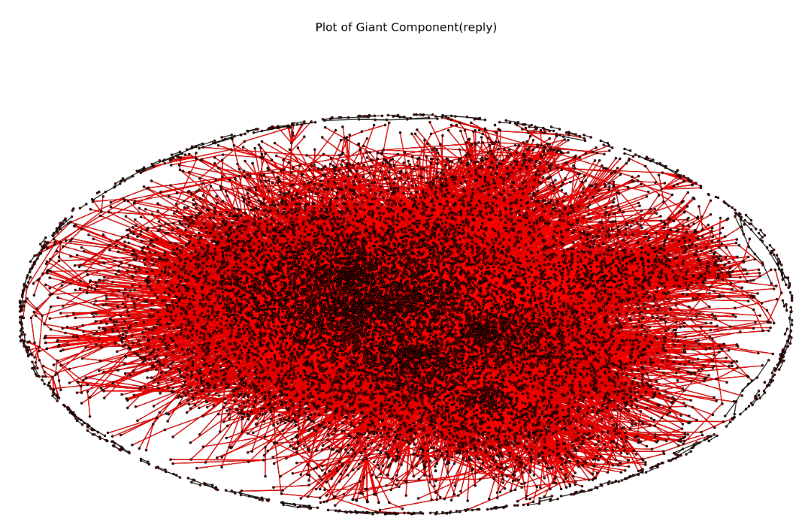
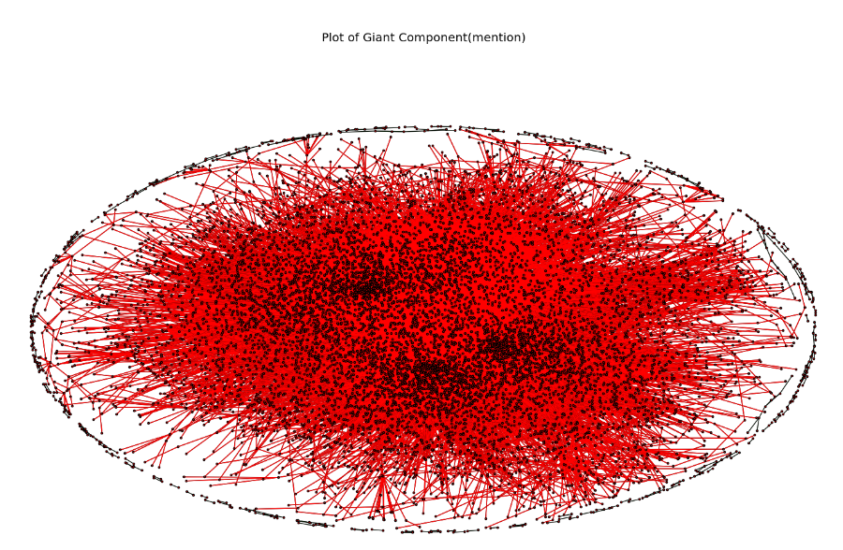
Components (Undigraph)
number of components in network: 66
the size of giant components: 3892/4038 ratio: 96.4%
number of components in network: 80
the size of giant components: 3332/3513 ratio: 94.8%

Slide 5
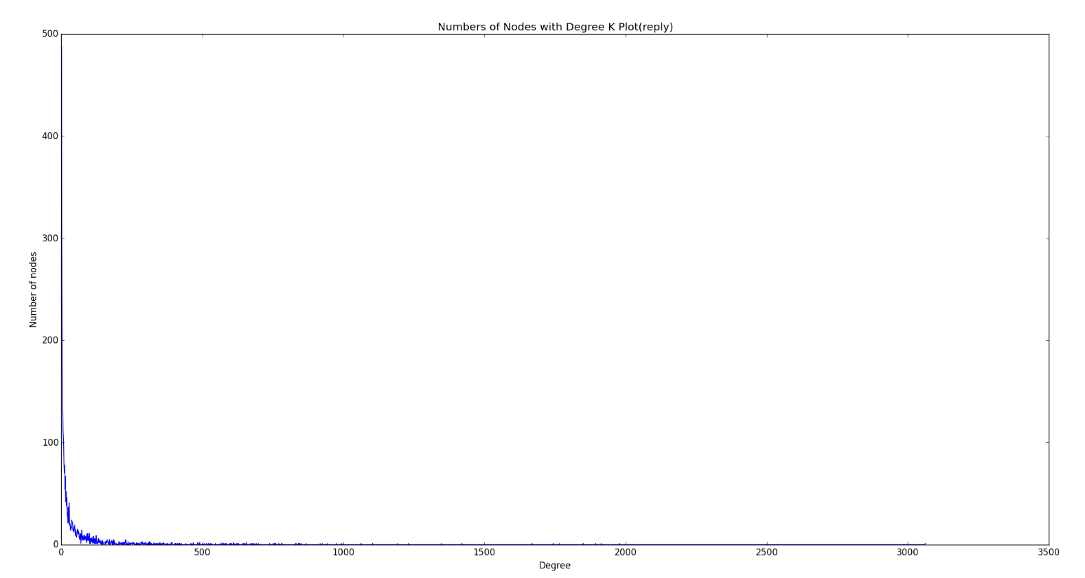
Degree distributions in DiGraphs

Slide 6
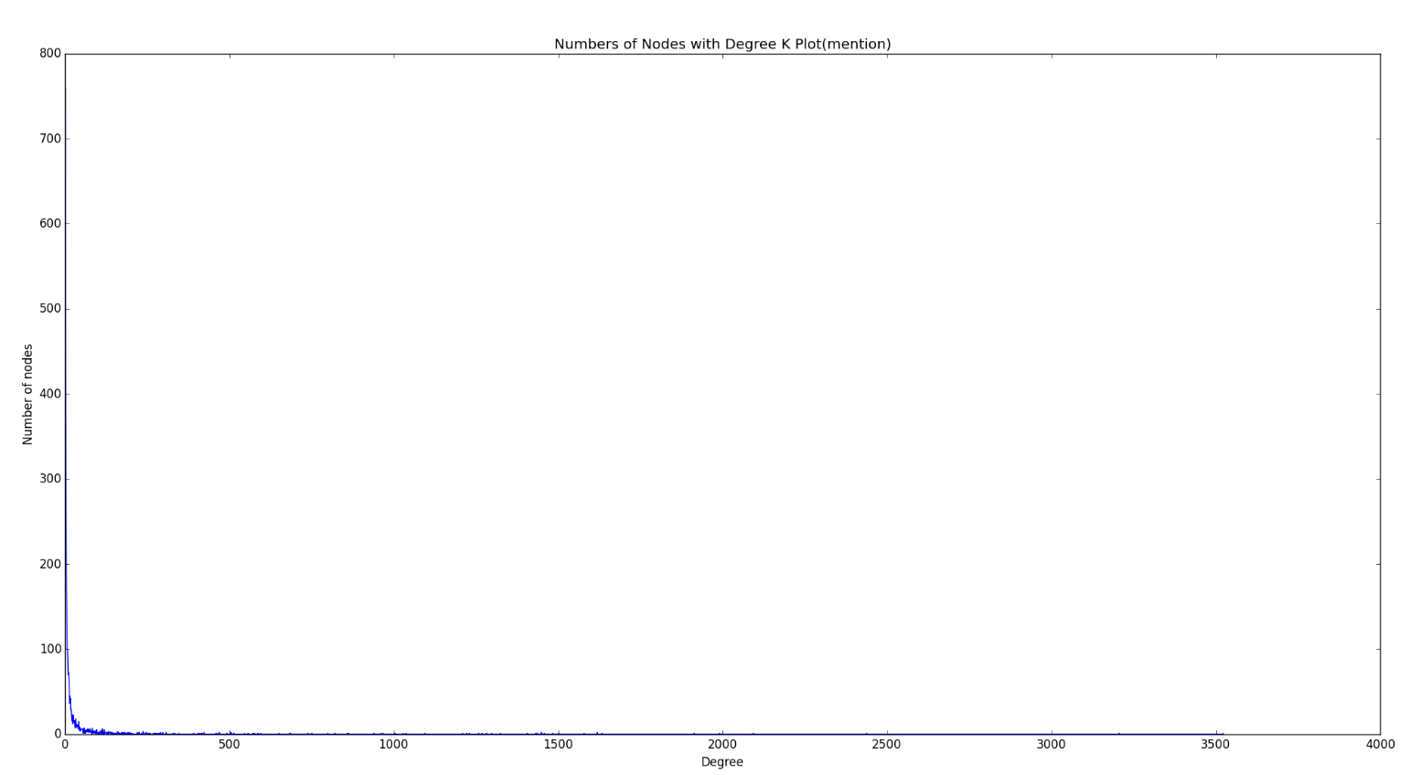
Degree distributions in DiGraphs

Slide 7
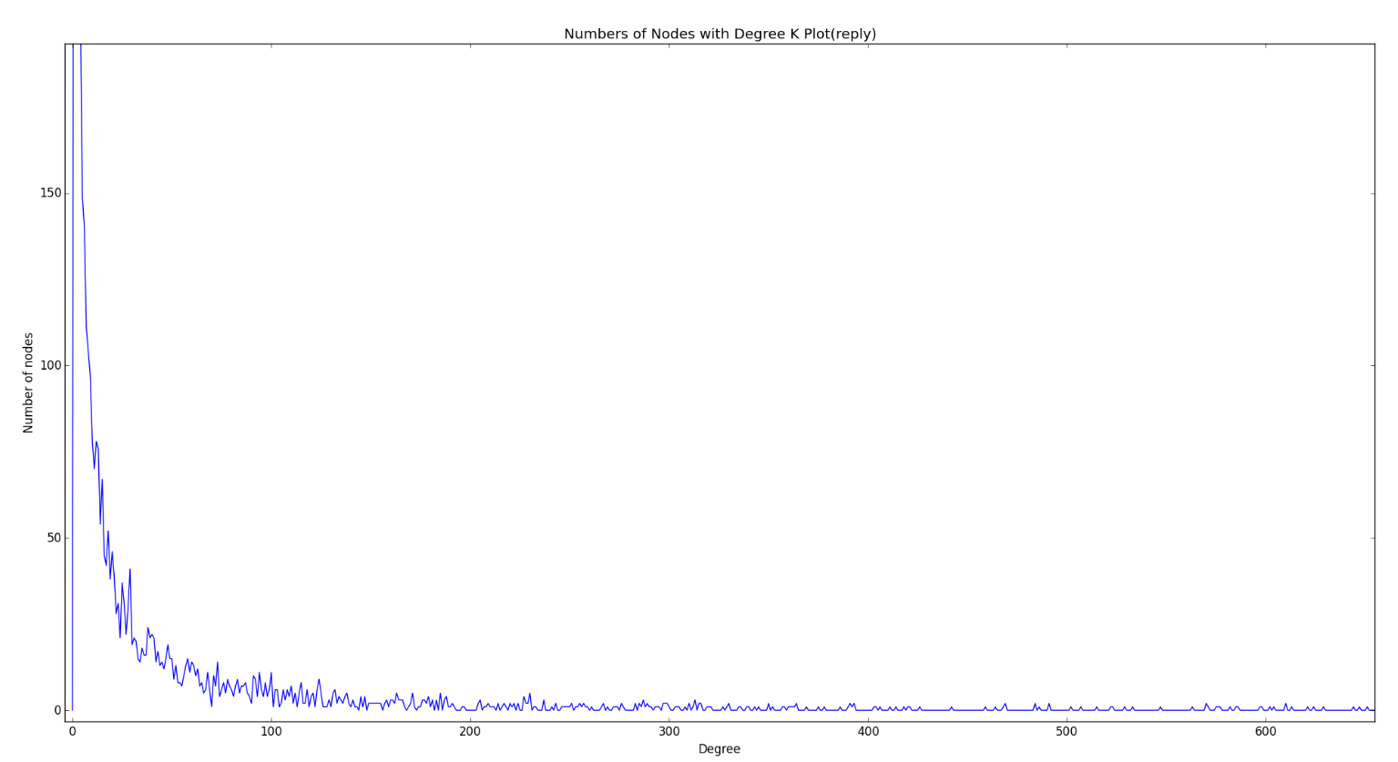
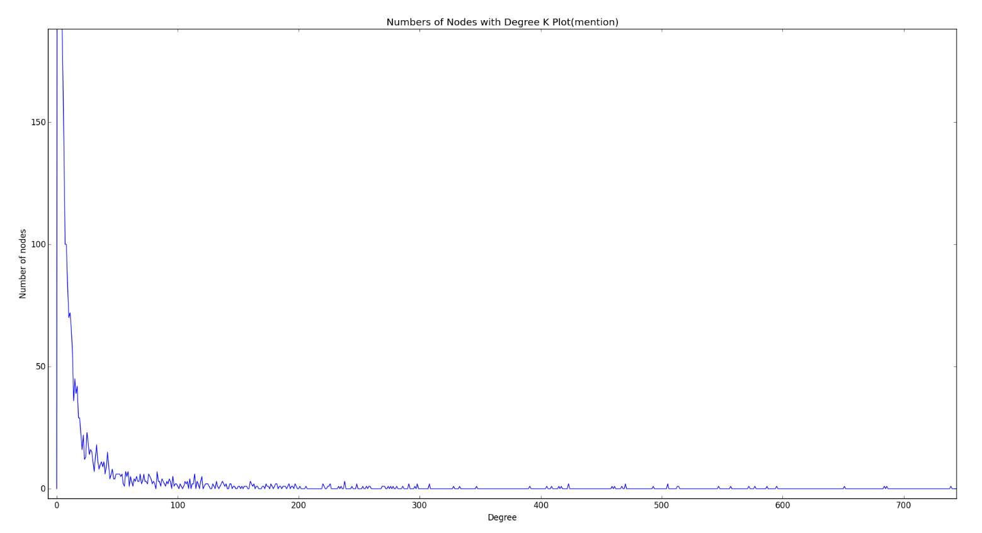
Degree distributions in DiGraphs
The numbers of nodes with the degree within [20, 75] in reply network are more than those in mention network.

Slide 8
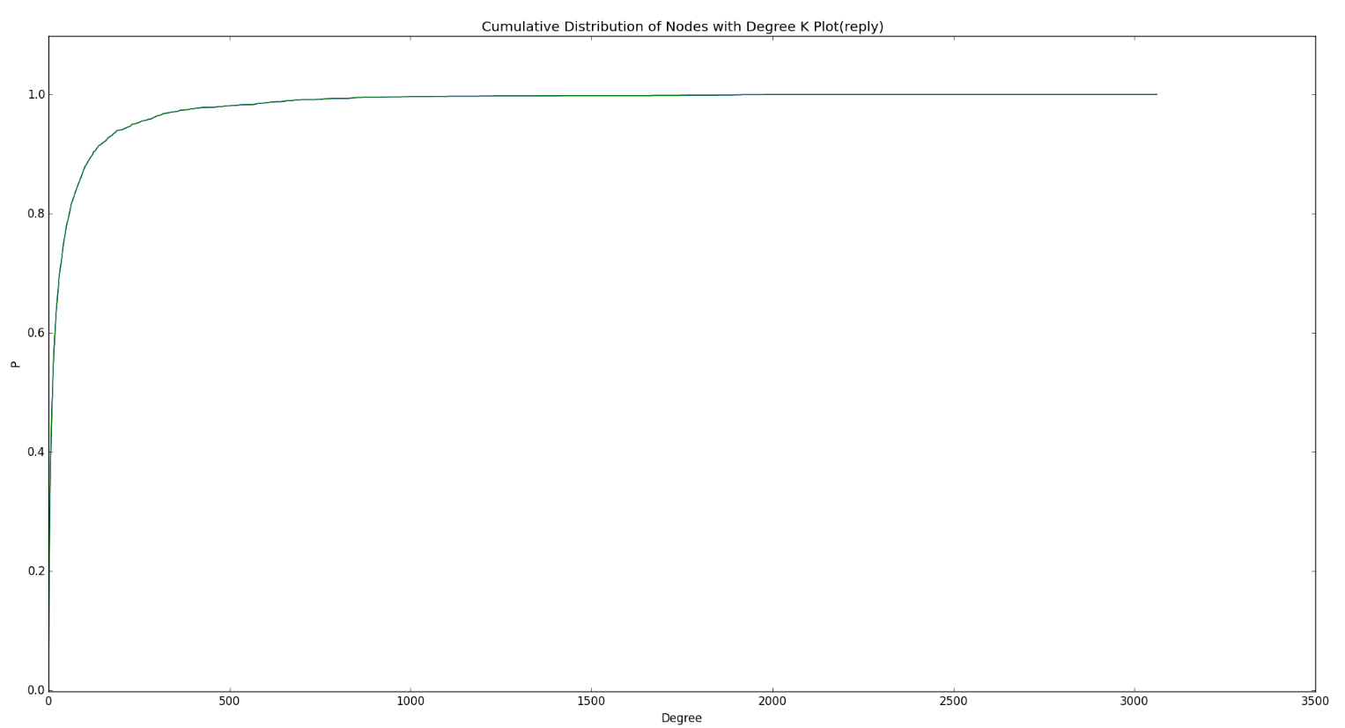
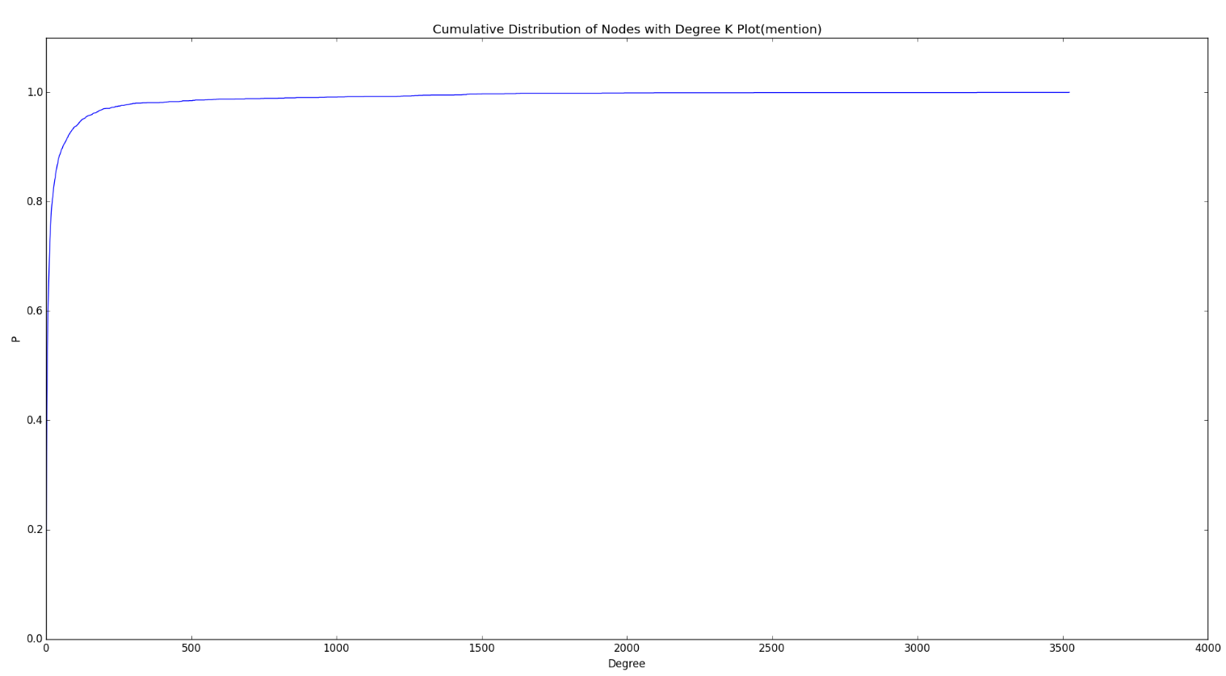
Degree distributions in DiGraphs
Hence, the cumulative probability of mention network reaches its peak in the smaller range of degrees than reply network.
→ How are their tail distributions?

Slide 9
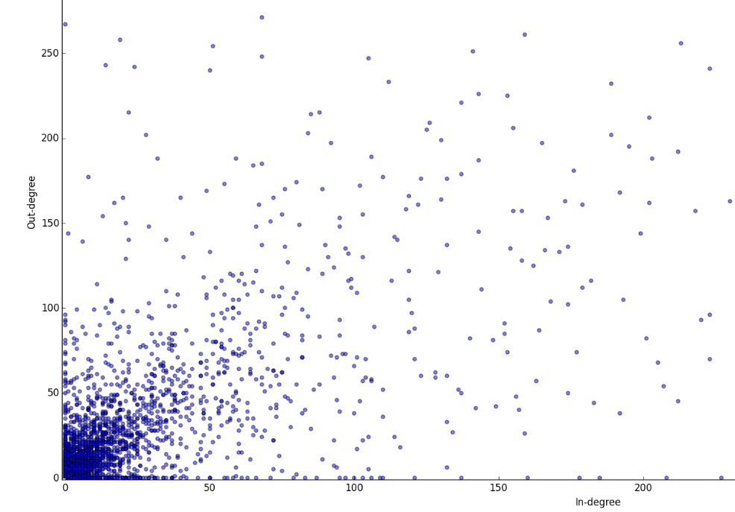
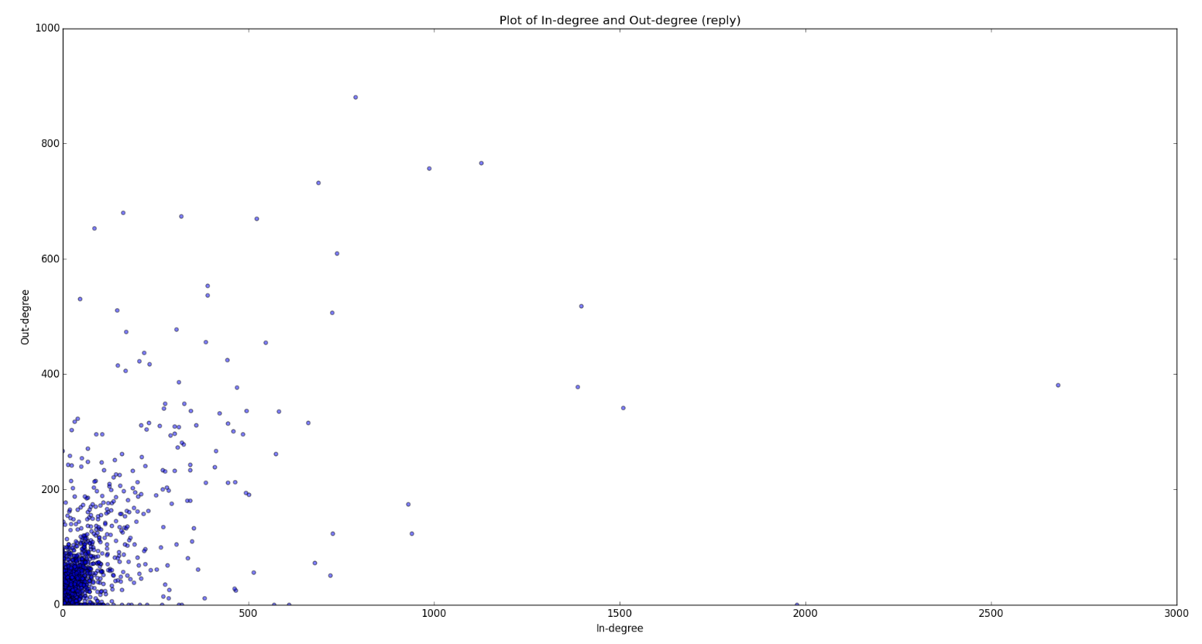
Relationship between reply indegree and outdegree
Avg(inD) = Avg(outD) = 26.8457157008
Pearson correlation: 0.622772

Slide 10
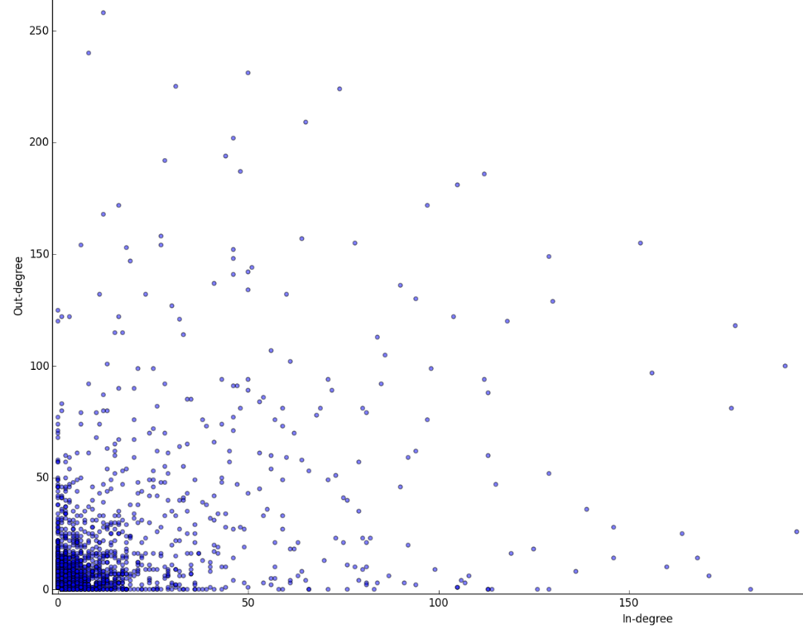
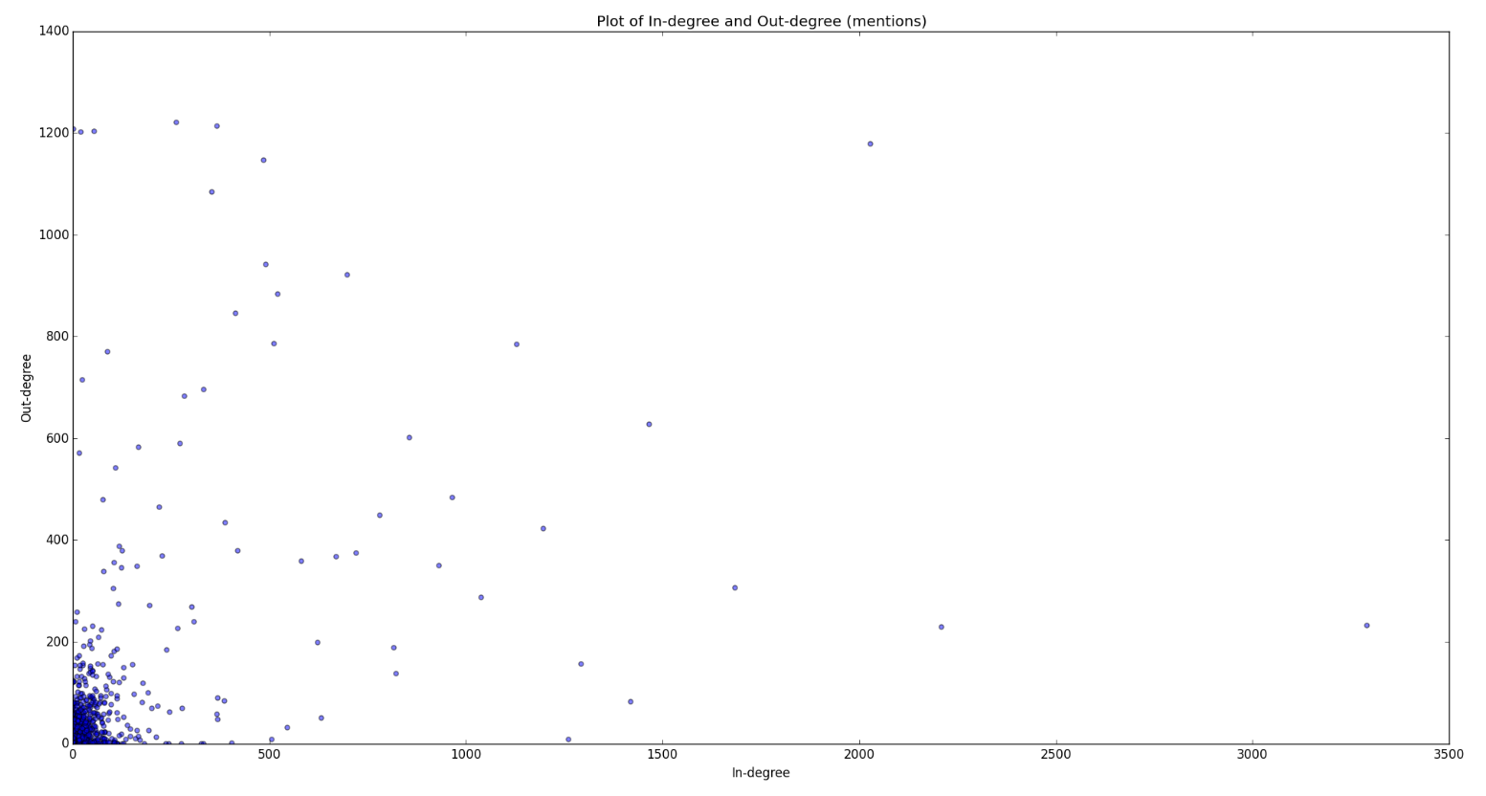
Relationship between mention indegree and outdegree
Avg(inD) = Avg(outD) = 19.0839738116
Pearson correlation: 0.476349

Slide 11
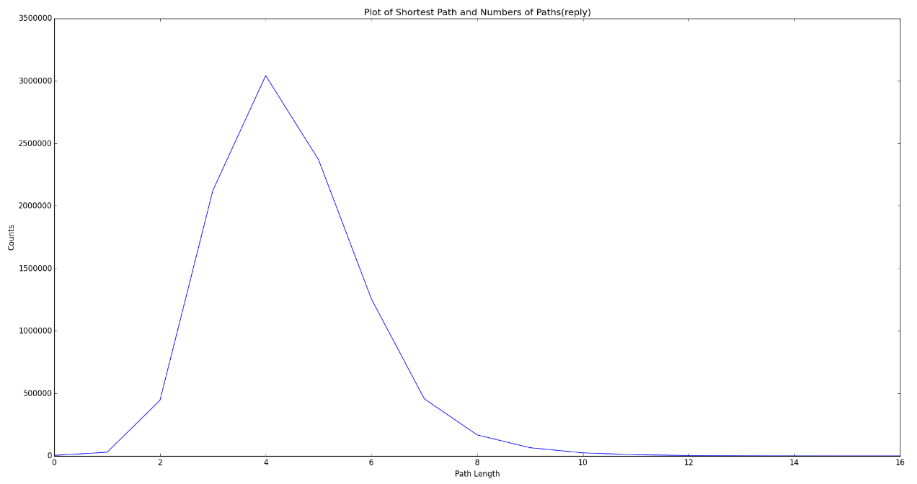
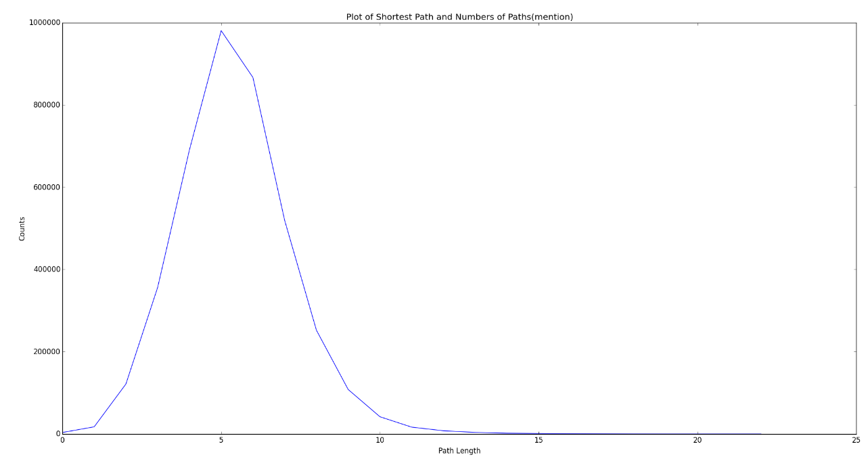
Directed Path distribution of users
The mean of path length is 4.438
The mean of path length is 5.419
The path of mention is generally longer than that of reply
→ the reachability of reply is typically higher than mention

